Slide 1

IBM Data Science Capstone Project
SpaceX Falcon-9
First stage landing prediction
August 2025
1

Slide 2
Outline
Executive Summary
Introduction
Methodology
Results
Conclusion
2

Slide 3



Executive Summary
This project explores the historical launch data of SpaceX’s Falcon 9 to understand and predict first stage landing outcomes
Steps:
Data collection (SpaceX API, Wikipedia)
Cleaning & transformation
EDA (SQL & visuals)
Interactive maps & dashboards
ML classification models
3

Slide 4
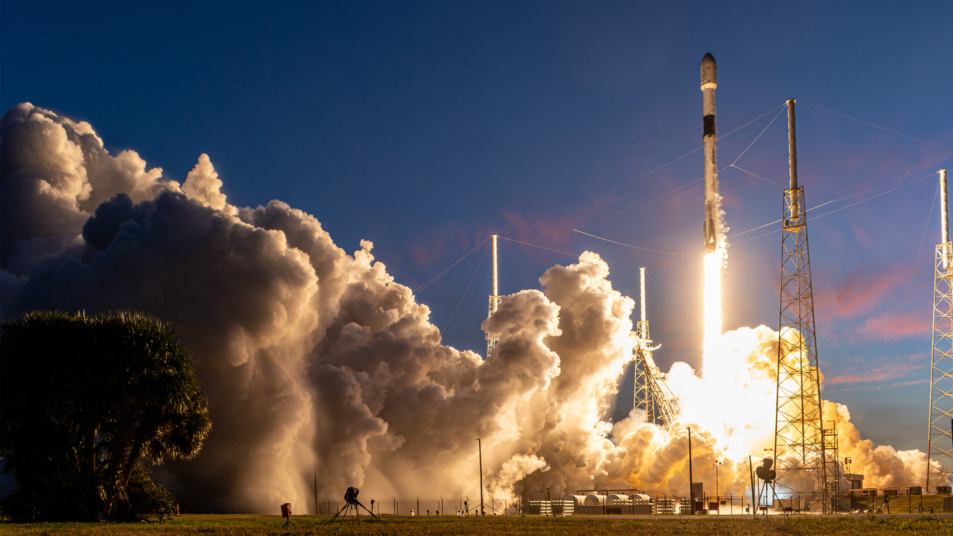
Introduction
SpaceX, founded in 2002, has transformed the aerospace industry by pioneering reusable rockets. Falcon 9, its flagship launch vehicle, is designed to significantly reduce the cost of spaceflight while maintaining high reliability.
We study historical data to:
Identify trends in mission outcomes
Predict landing success probability
4

Slide 5
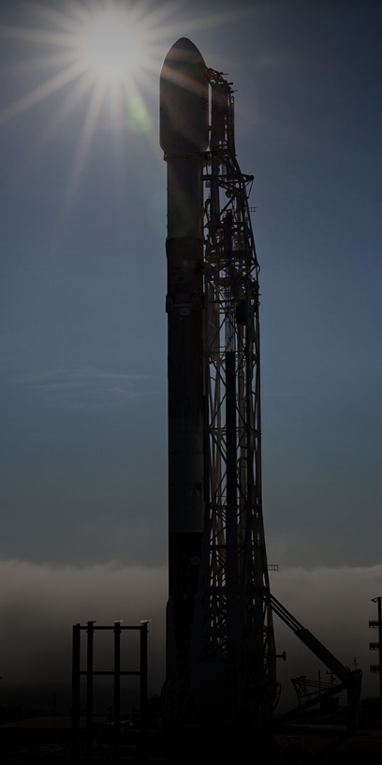
Methodology
Collect data from SpaceX API & Wikipedia
Data Wrangling: cleaning, feature engineering
EDA with Visualization & SQL
Interactive Analysis with Folium & Plotly
Machine Learning Classification Models
5

Slide 6
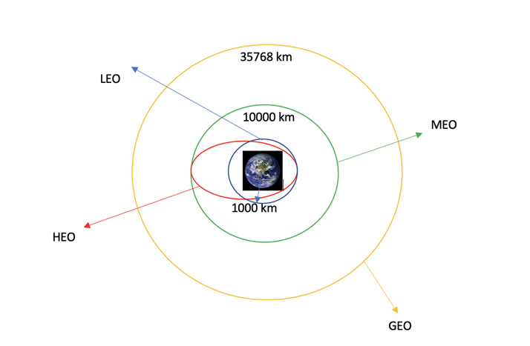
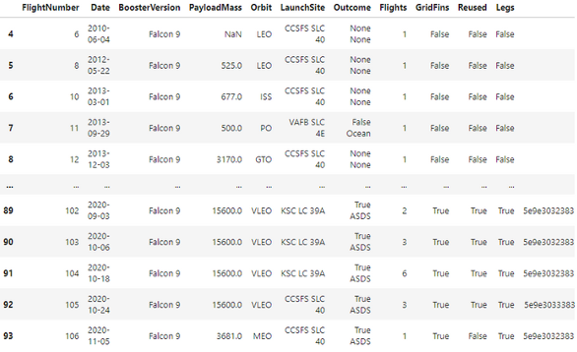
Data Collection & Wrangling Methodology
Sources:
SpaceX REST API
Wikipedia Launch Records
Steps:
API request & JSON parsing
HTML table extraction via Beautiful Soup
Merge datasets, standardize columns
Create target variable "Landing Success"
6

Slide 7
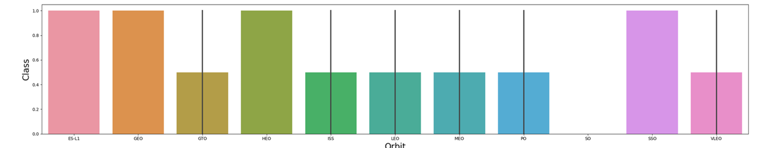
EDA & Interactive Visual Analytics Methodology
Visualization: Matplotlib, Seaborn for trends & correlations
SQL queries for targeted insights
Folium maps for geographic visualization of launch sites
Plotly Dash for interactive dashboards
7

Slide 8
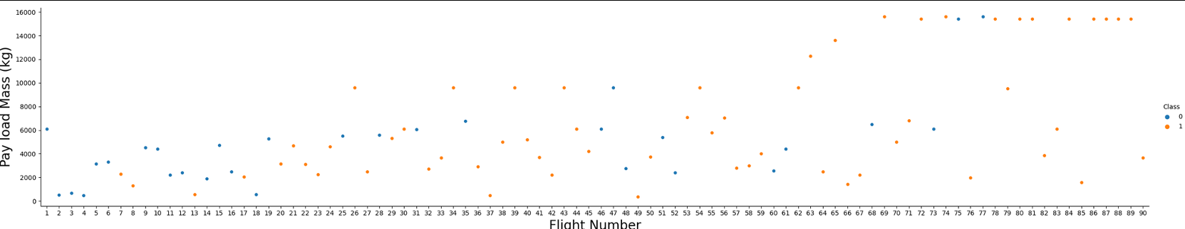
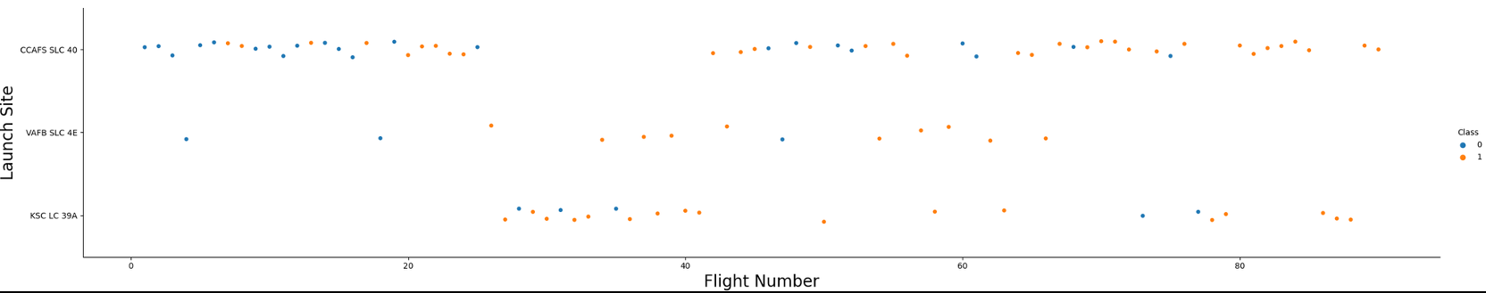
EDA with Visualization Results
Success rates vary by launch site: CCAFS LC-40 — 60%, KSC LC-39A and VAFB SLC-4E — 77%
Plot FlightNumber vs LaunchSite using catplot with x=FlightNumber, y=Launch Site, hue=class.
8

Slide 9
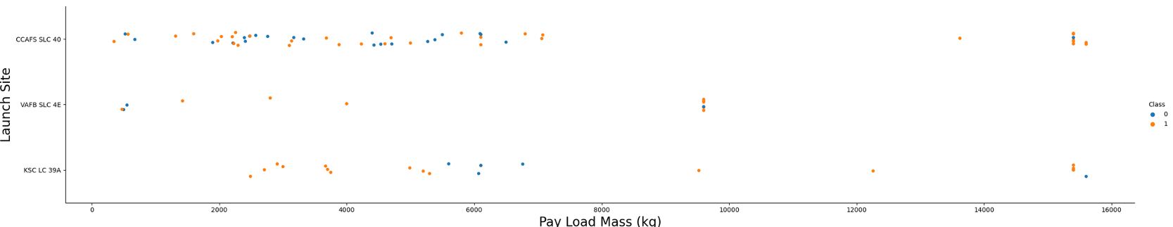
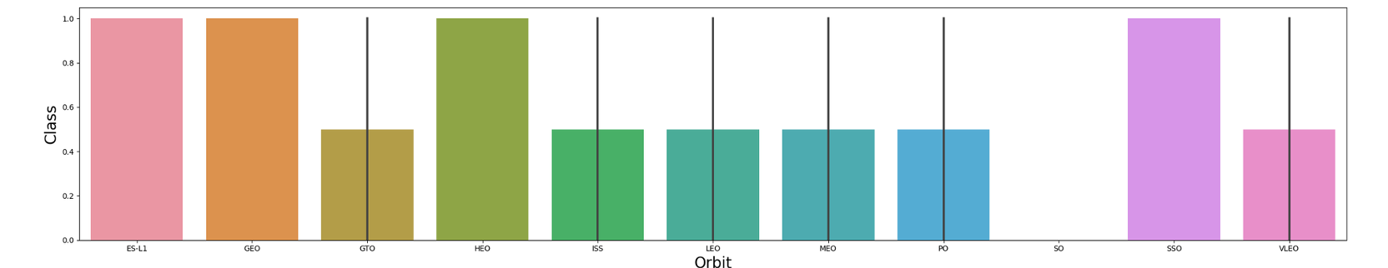
EDA with Visualization Results
Check for correlation between launch site and payload mass.
Show success rate by orbit type
9

Slide 10
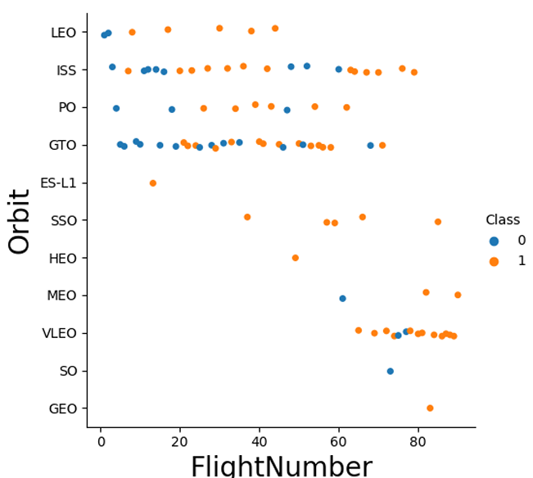
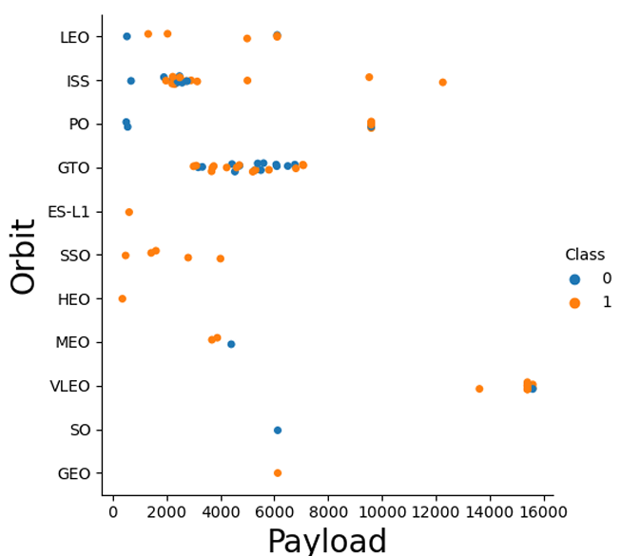
EDA with Visualization Results
Plot Payload vs Orbit type
Show yearly trend of launch success
10

Slide 11
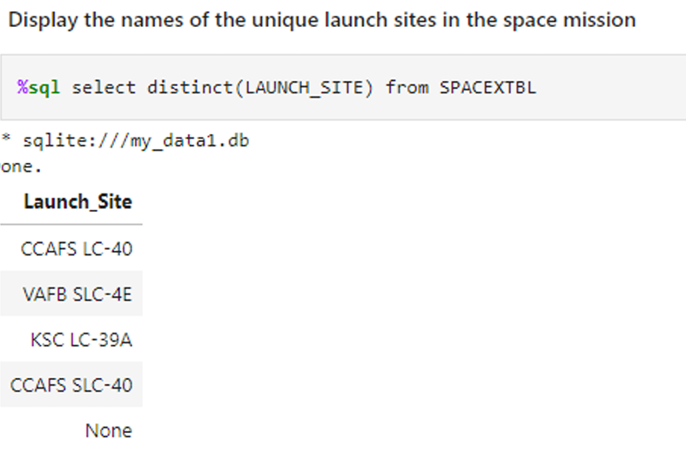
EDA with SQL Results
Average payload mass per booster type
First successful landing date on ground pad
Launch sites with highest success
Missions with specific payload ranges
Display the names of the unique launch sites in the space mission
11

Slide 12
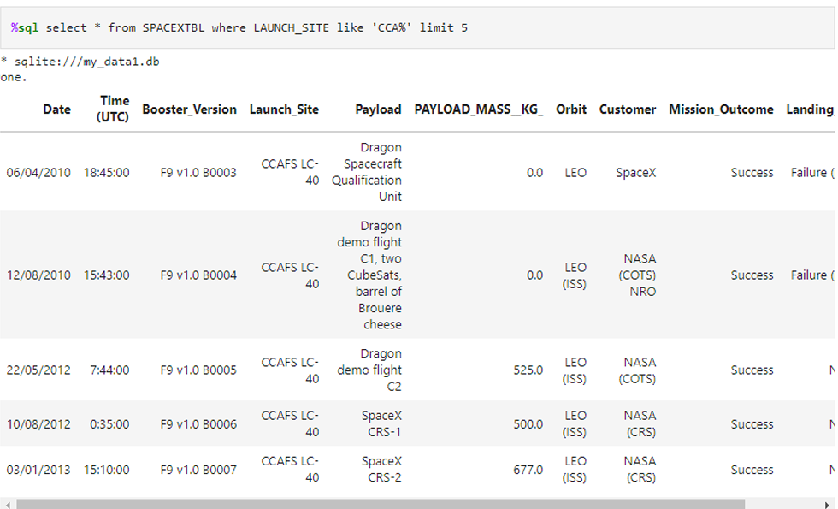
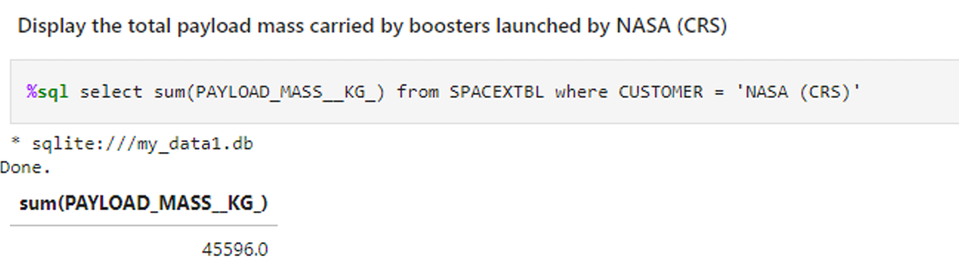
EDA with SQL Results
Display 5 records where launch sites begin with the string 'CCA'
Display the total payload mass carried by boosters launched by NASA (CRS)
12

Slide 13
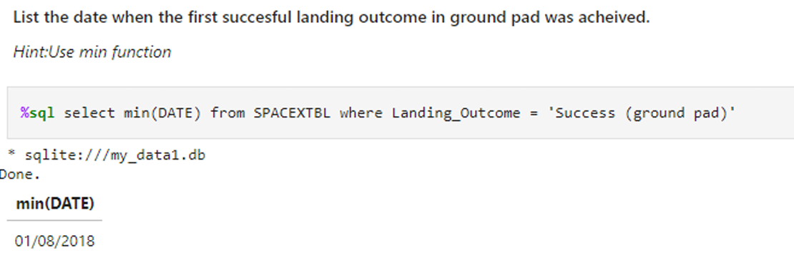
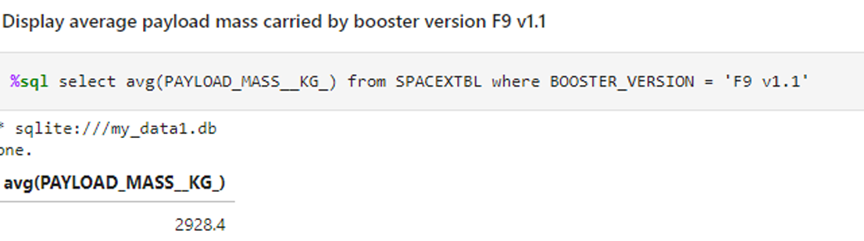
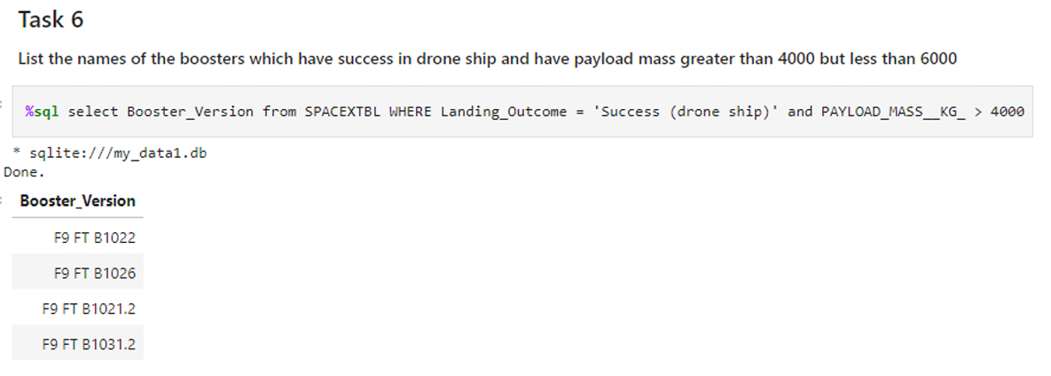
EDA with SQL Results
Display average payload mass carried by booster version F9 v1.
List the date when the first succesful landing outcome in ground pad was acheived.
List the names of the boosters which have success in drone ship and have payload mass greater than 4000 but less than 6000
13

Slide 14
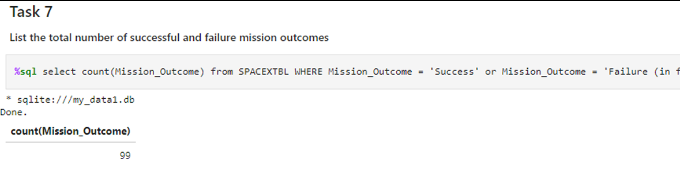
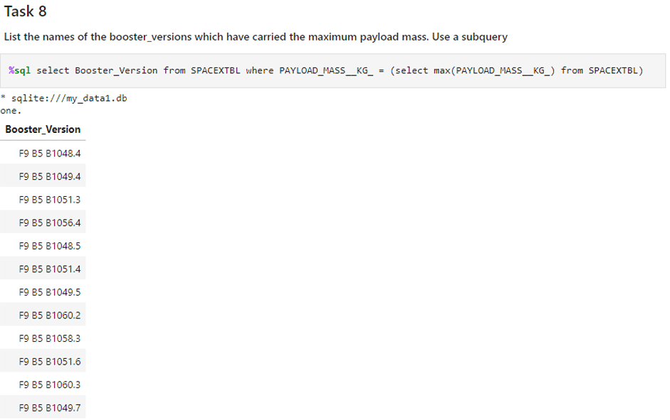
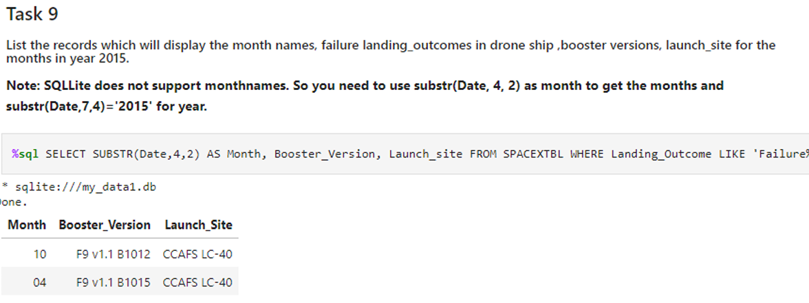
EDA with SQL Results
List the total number of successful and failure mission outcome
List the names of the booster_versions which have carried the maximum payload mass. Use a subquery
14

Slide 15
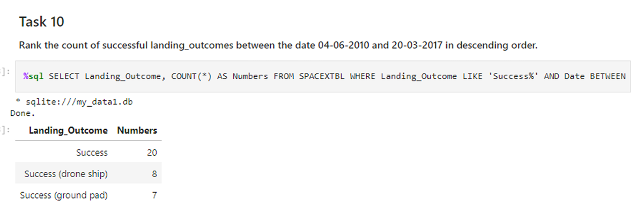
EDA with SQL Results
List the records which will display the month names, failure landing_outcomes in drone ship, booster versions, launch_site for the months in year 2015
Rank the count of successful landing_outcomes between the date 04-06-2010 and 20-03-2017 in descending order
15

Slide 16
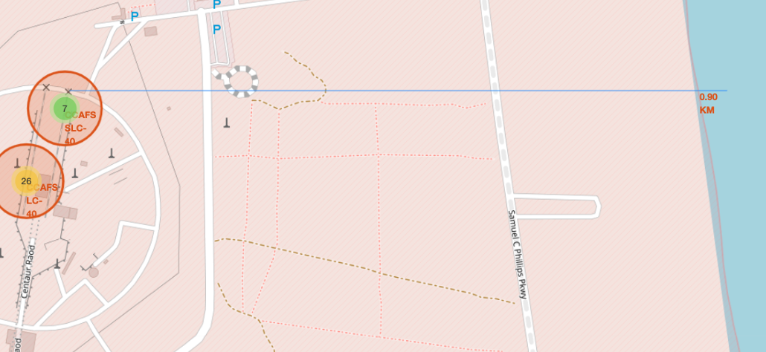
Interactive Analysis with Folium & Plotly
16

Slide 17
Machine Learning Classification Models
We output the GridSearchCV object for logistic regression. We display the best parameters using the data attribute best_params_ and the accuracy on the validation data using the data attribute best_score_.
Best accuracy: 84% — Decision Tree
Payload mass, orbit type, and launch site are key predictors.
17

Slide 18
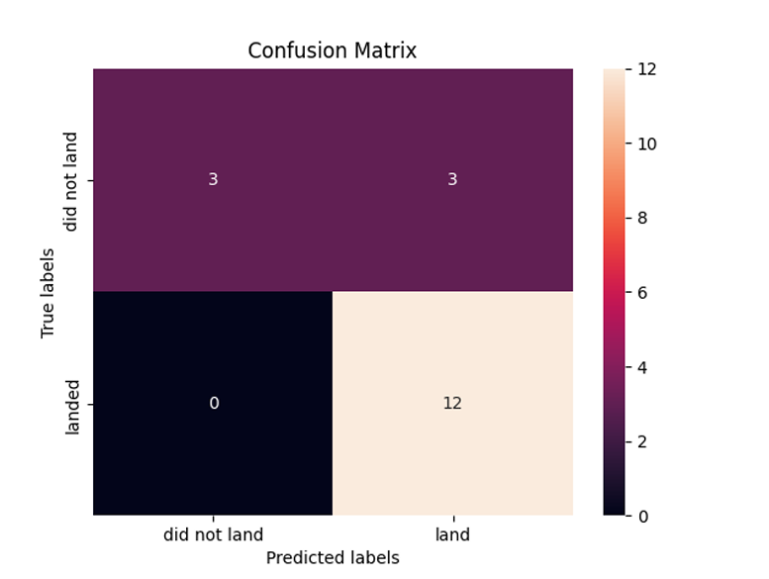
Machine Learning Classification Models
18

Slide 19
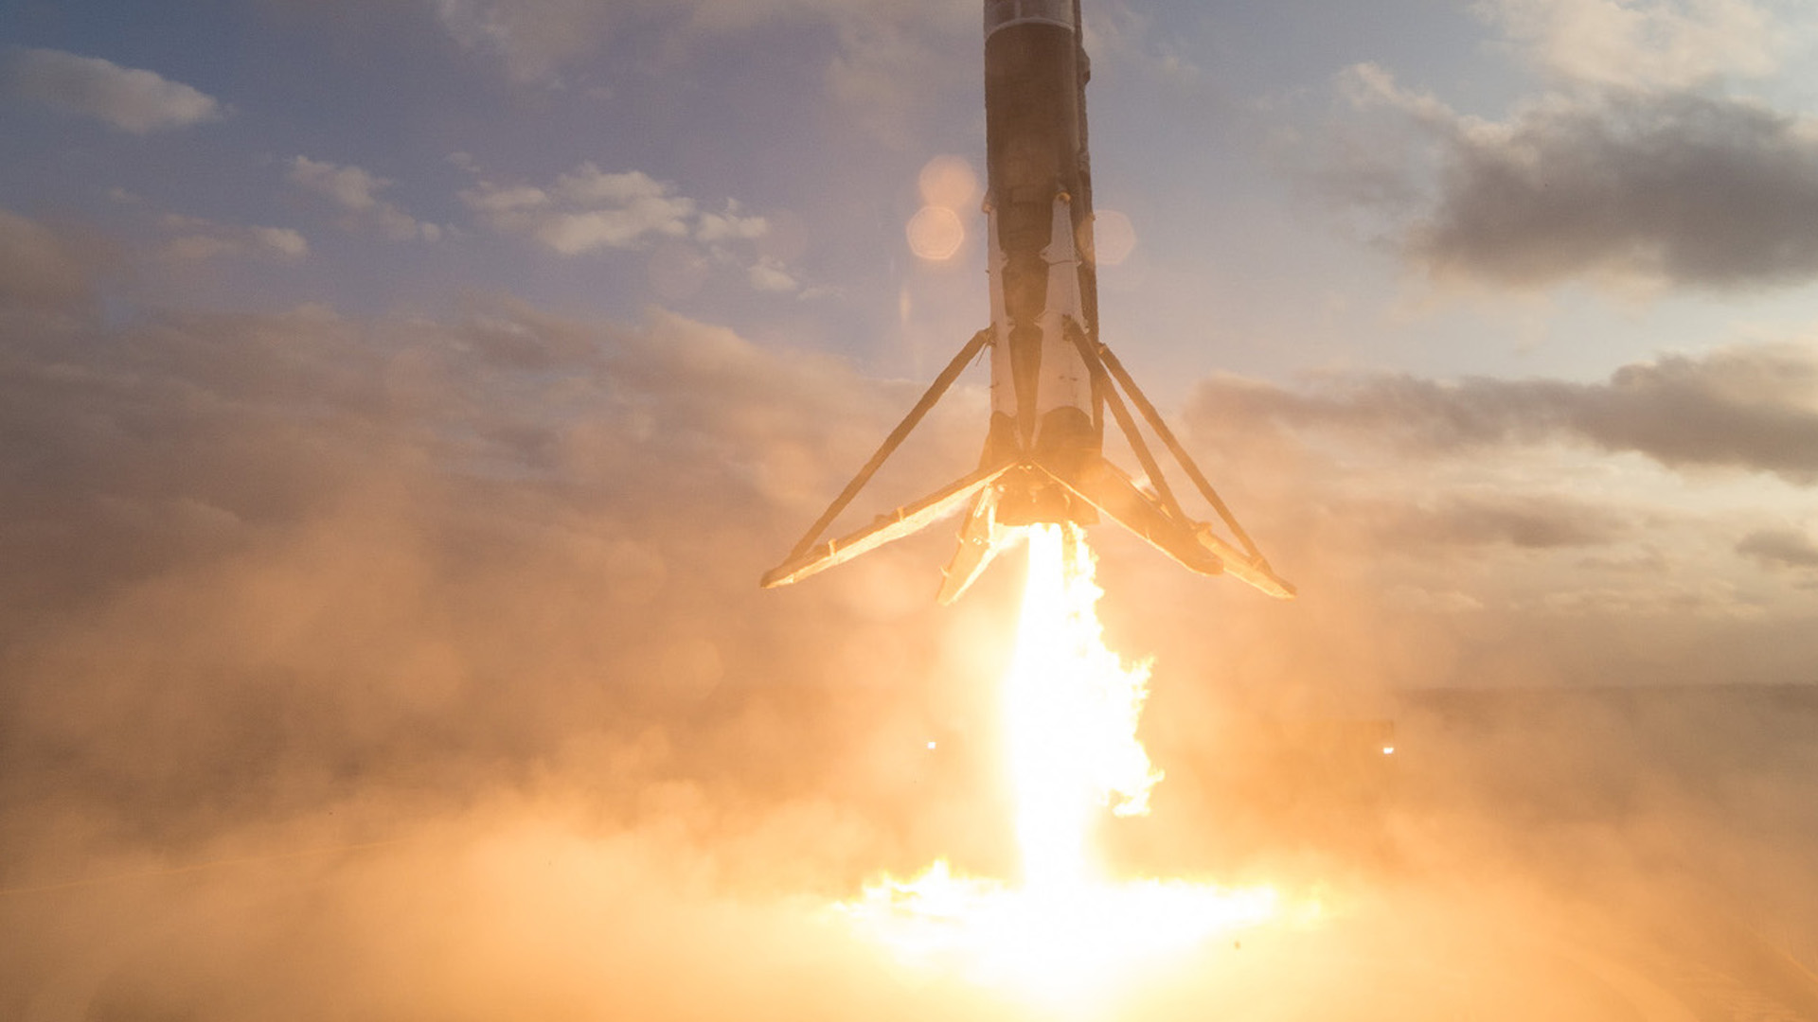
Conclusion
Launch site and payload mass strongly influence landing success.
Certain orbit types yield higher success rates.
Interactive tools and ML models provide actionable insights for future launches
20

Slide 20
Appendix & Resources
GitHub Repository: https://github.com/o-boro/Final-project-Space-X-Falcon-9-
Data sources: SpaceX API, Wikipedia
Libraries: Pandas, Matplotlib, Seaborn, Folium, Plotly Dash, Scikit-learn
21

Slide 21

Thank you for your time and attention!
22

